Slide 1

Artificial Intelligence

Slide 2
Today we will cover
01
Agents and Rationality
A brief introduction of Intelligent Agents with the help of existing examples.
02
PEAS
Performance Measure of Intelligent Agents
03
Environment Types
Different types of task environments
04
Agent Types
Basic structures of agents

Slide 3
01
Agents and Rationality
A brief introduction of Intelligent Agents with the help of existing examples.

Slide 4
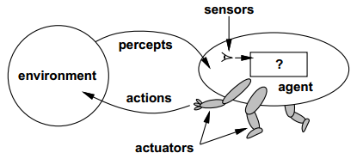
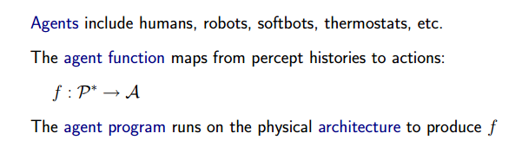
What is an agent?
Notes:
1.

Slide 5
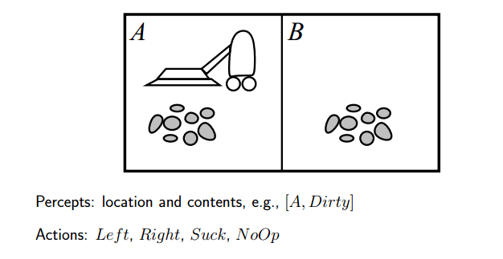
Vacuum Cleaner World
Notes:
1.

Slide 6
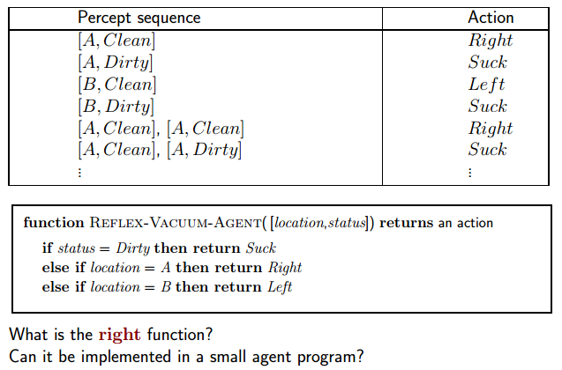
Vacuum Cleaner Agent
Notes:
1.

Slide 7
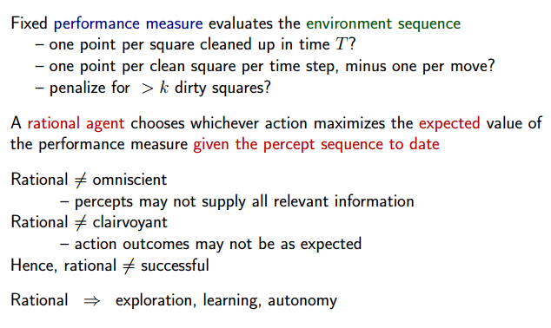
Rationality

Slide 8
Rationality
Perfect Rationality
Calculative Rationality
Bounded Rationality
Bounded Optimality

Slide 9

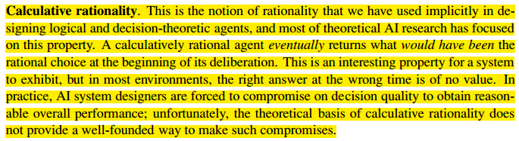

Slide 10
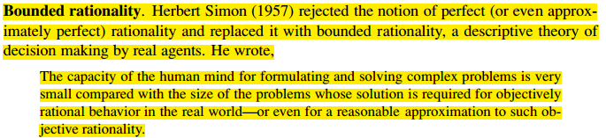
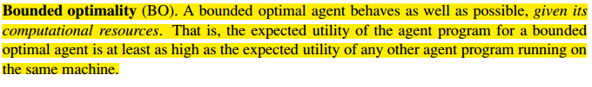

Slide 11
02
PEAS
Performance Measure of Intelligent Agents

Slide 12
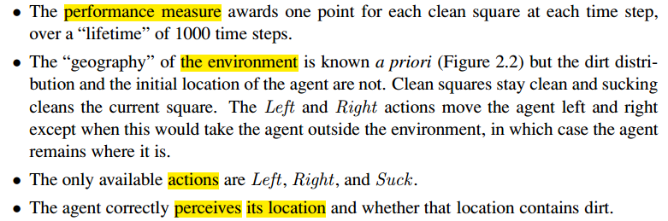
PEAS

Slide 13
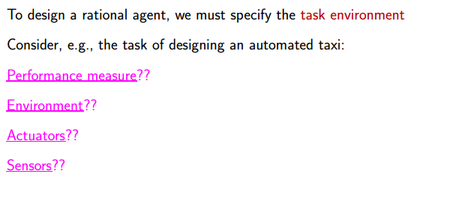
Automated Taxi Agent

Slide 14
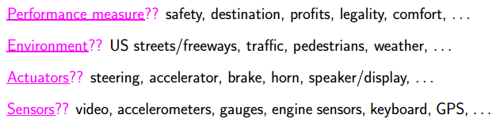
Automated Taxi Agent

Slide 15
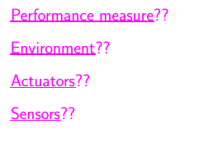
Internet Shopping Agent

Slide 16
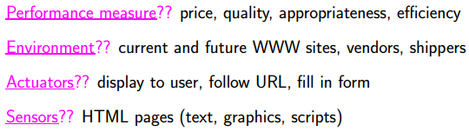
Internet Shopping Agent

Slide 17
Medical Diagnosis System

Slide 18
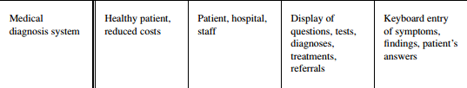
Medical Diagnosis System

Slide 19
Part Picking Robot

Slide 20

Part Picking Robot

Slide 21
Refinery Controller

Slide 22

Refinery Controller

Slide 23
Interactive English Tutor

Slide 24

Interactive English Tutor

Slide 25
03
Environment Types
Different types of task environments

Slide 26
Environment Types
Fully Observable vs. Partially Observable
Single Agent vs. Multi-agent
Deterministic vs. Stochastic vs. Non-deterministic
Episodic vs. Sequential
Static vs. Dynamic vs. Semi-dynamic
Discrete vs. Continuous
Known vs. Unknown

Slide 27
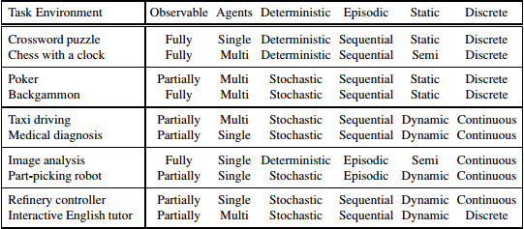
Environment Types

Slide 28
04
Agent Types
Basic structures of agents

Slide 29
Agent Types
Simple Reflex Agent
Model-based Reflex Agent
Model-based Goal-based Agent
Model-based Utility-based Agent
Learning Agent

Slide 30
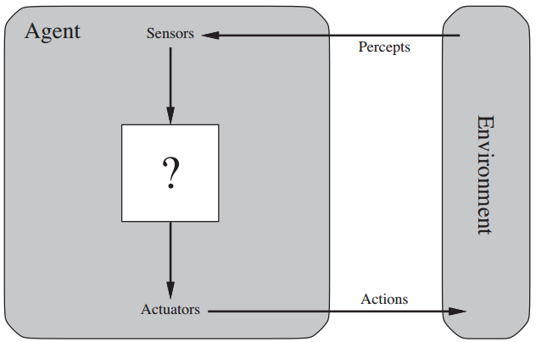
Agent

Slide 31
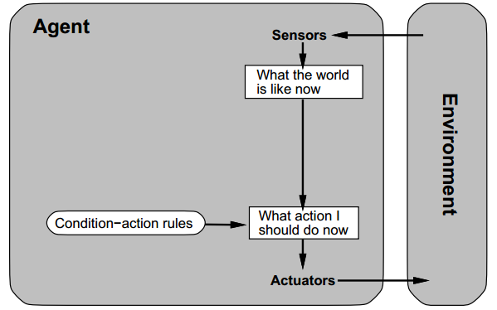
Simple Reflex Agent

Slide 32
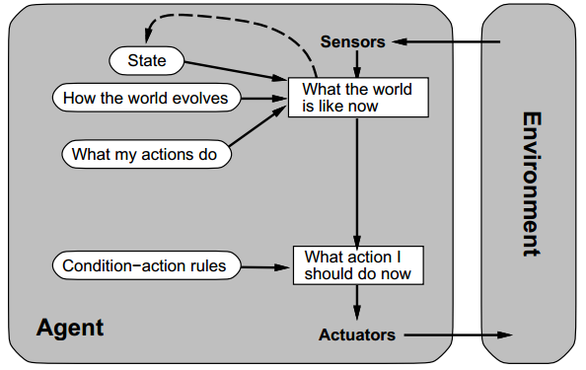
Model-based Reflex Agent

Slide 33
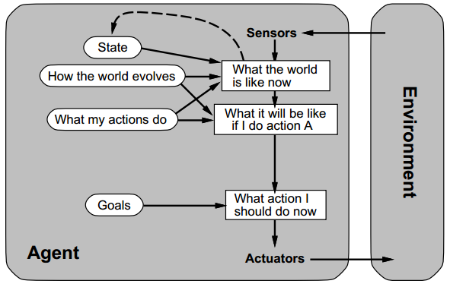
Model-based Goad-based Agent

Slide 34
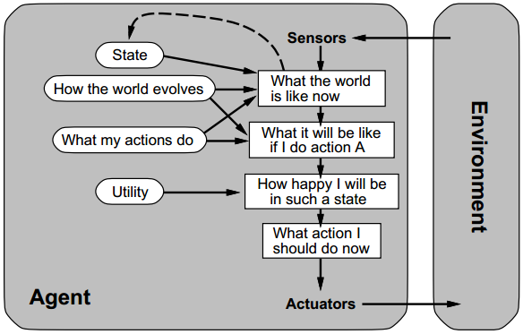
Model-based Utility-based Agent

Slide 35
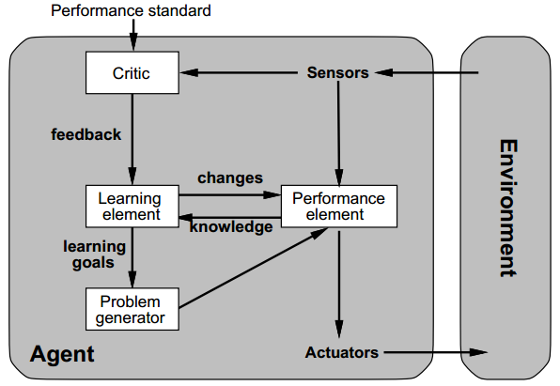
Learning Agent

Slide 36
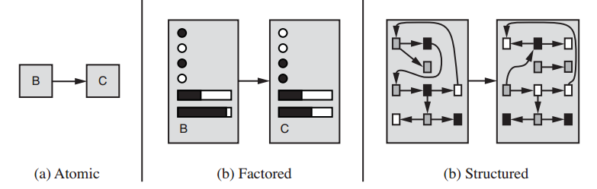
How the components of agent programs work?

